Slide 1

A Systematic Literature Review on the Effect of Code Smells on Non-Functional Attributes of Source Code PROJECT STATUS
Università degli Studi di Salerno
Dipartimento di Informatica
Nazira Munalbayeva
University of Salerno
n.munalbayeva@studenti.unisa.it

Slide 2
Motivation
We are interested about how big is the impact of code smells in a project, for understanding if is really worth to work for individuate and refactor code smells or this operation can be neglected.
During the review of the literature, it was found that there is no systematic review of the influence of the code smells on the NFA of source code. Therefore, we study research using an existing database to reduce research gaps.

Slide 3
Goals
Conduct a systematic analysis of academic articles on "The Effect of Code Smells on Non-Functional Attributes of Source Code".
Analyze how code smells impact the NFA of Source Code.

Slide 4
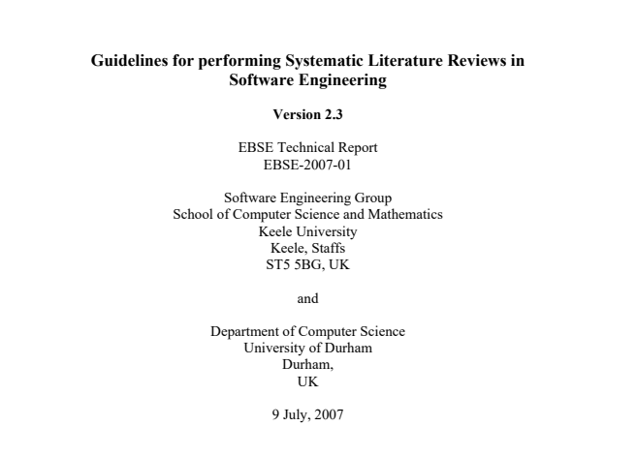
Kitchenham, B. and Charters, S. (2007) Guidelines for Performing Systematic Literature Reviews in Software Engineering, Technical Report EBSE 2007-001, Keele University and Durham University Joint Report.
Grant Oosterwyk, Irwin Brown and Sharon Geeling (2019), A Synthesis of Literature Review Guidelines from Information Systems Journals, Proceedings of 4th International Conference on the Internet, Cyber Security and Information Systems 2019

Slide 5
Research Methodology
A systematic literature review gathers existing information related to specific research and provide confidence to the author to synthesize conclusion. The steps in performing the SLR are shown in the next slide.

Slide 6
Systematic literature review process
1. Specify Research Questions
2. Develop Review Protocol
3. Identify Relevant Research
4. Select Primary Studies
5. Asses Study Quality
6. Extract Required Data
7. Synthesize Data
8. Write Review Report
9. Validate Report
Plan review
Conduct review
Document review

Slide 7
The research questions
In which way a Code Smell Impact on NFA?
Which tools, resources and techniques were used to find evidence of the influence of code smells on NFA?
Are all code smells impactful on NFA?
We aim to answer the following research questions by conducting a methodological review of existing research.

Slide 8
Review Protocol
A review protocol specifies the methods that will be used to undertake a specific systematic review. A pre-defined protocol is necessary to reduce the possibility of researcher bias. For example, without a protocol, it is possible that the selection of individual studies or the analysis may be driven by researcher expectations.
The components of a protocol include all the elements of the review plus some additional planning information

Slide 9
Stages of the study selection process
ACM
Step 1 - Search string results applied in digital libraries
Google scholar
Step 2—Read titles and abstracts to identify potentially relevant studies
IEEExplore
Step 3 – Apply inclusion and exclusion criteria
Science
Direct
Scopus
Step 4 – Critical evaluation of the primary studies at hand

Slide 10
Identify Relevant Research
Searching for Study Sources
A selection of keywords was made for the search for primary study sources, based on the above research questions. We searched for studies published in journals and conferences from 2010 to 2020. The search string below was applied to 5 digital libraries meeting the guidelines described in on the basis of three points of view: population, intervention and result.
Key words:
("Non-functional attributes" OR "NFA" OR "Non-functional requirements") AND ("code-smell" OR "bad smell" OR "code anomalies") AND ("effect" OR "impact" OR "influence")

Slide 11
Inclusion criteria: 1/ Publications should be "journal" or "conference“; 2/ Works that involve some empirical study or present "lessons learned" (e.g., experience report); 3/ If several journal articles report the same study, the most recent article should be included.
Exclusion criteria:
1/ Studies that do not answer the research question;
2/ Publications which are previous versions of work also presented in later publications;
3/ Publications published before 2010;
4/ Studies that are focused only on code smells or on NFA of source code without any discussion regarding the relationship and/or influence that the first exert on the second.

Slide 12
Quality Criteria
Is the document based on empirical evidence or just based on expert opinion?
Is there a clear statement of the research objectives?
Is there an adequate description of the context in which the research was carried out?
Was the research project suitable to address the research objectives?
Was data collected to address the research question?
Is there a clear statement of the findings?

Slide 13
Data Extraction
The data extraction forms must be designed to collect all the information needed to address the review questions and the study quality criteria.

Slide 14
Data Synthesis
Data synthesis involves collating and summarising the results of the included primary studies. Using statistical techniques to obtain a quantitative synthesis .
Based on the results of the selection process , I will list and classify the selected primary studies in a spreadsheet to enable a clear understanding of aims, methodologies and findings. The spreadsheet will organize the select studies using the following fields:
identification number;
year;
title;
objectives or aims;
code smells;
analysed projects;
research questions and respective answers;
code smells that have influence on NFA;
software projects or method that illustrate this influence.

Slide 15
Literature Management: Mendeley is a free reference manager and an academic social network.
A Tool for Performing Systematic Literature Reviews
With Mendeley Reference Manager:
-Store, organize and search all references from just one library.
-Seamlessly insert references and bibliographies into your Microsoft® Word documents using Mendeley Cite.
-Read, highlight and annotate PDFs, and keep all your thoughts across multiple documents in one place.

Slide 16
Result
The final phase of a systematic review involves writing up the results of the review and circulating the results to potentially interested parties. Results will include answers to research questions .

Slide 17
References
Kitchenham, B. and Charters, S. (2007) Guidelines for Performing Systematic Literature Reviews in Software Engineering, Technical Report EBSE 2007-001, Keele University and Durham University Joint Report.
Grant Oosterwyk, Irwin Brown and Sharon Geeling (2019), A Synthesis of Literature Review Guidelines from Information Systems Journals, Proceedings of 4th International Conference on the Internet, Cyber Security and Information Systems 2019

